Slide 1
FARDIN’S DATA ANALYSIS AND VISUALIZATION PROJECT KPI DASHBOARD FOR AUTOMOBILE RETAIL COMPANY
SALES INSIGHTS REPORT 2003-05

Slide 2
BUSINESS OBJECTIVE
This is an automobile retail company chains across various cities and countries of India
The Managing director / CEO of wants to incorporate ‘Business and Data Intelligence’ to identify and track the source of revenue for the company
Hence, it is decided to develop a KPI Dashboard using Jan-03 to May-05 data, which can help track its revenue sources and other relevant KPIs across various dimensions
It’ll help the management take strategic business decisions based on the insights generated from the dashboard

Slide 3
PROBLEM STATEMENT / PROJECT SCOPE
Identify the data sources pertaining to revenue management
Clean and model the data as per requirement for analysis
Create a revenue dashboard that measures important KPIs
Relevant filters need to provided to slice and dice the data
The dashboard should depict both high level and granular insights

Slide 4
SOLUTION APPROACH
The data consists of table provided for tracking revenue, which consists of sales, order date, order status, product line and countries.
Power BI was the tool used for creating the visualization/dashboard
The data was imported, analysed and transformed as per necessity within Power Query
Importing data from a folder so that even if we add upcoming month’s data it can be updated automatically.

Slide 5
SOLUTION APPROACH
A few measures were created to calculate the KPIs as shown below:
Sales = Sum of sales from shipped items (in dollars)
Total Number of Orders = Count of Order ID from the table
Quantity Sold = Total number of products sold
Order Status = Count of orders status from the table
Quarters = Total Sales of each quarter from the table

Slide 6
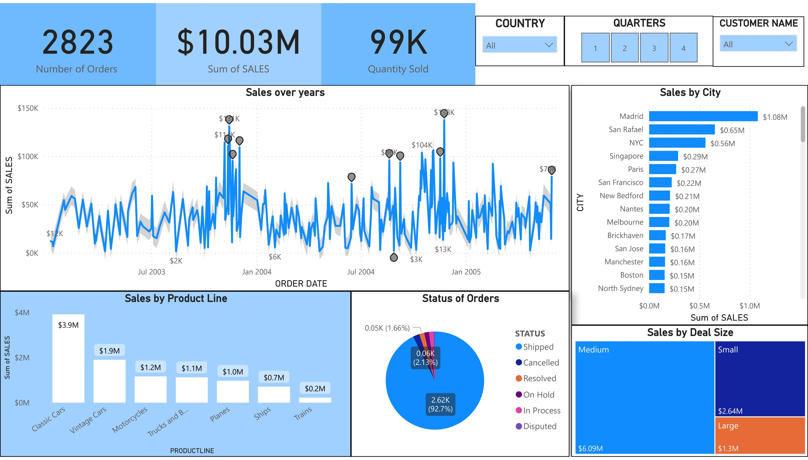

Slide 7
FEATURES OF THE DASHBOARD
The following 5 visuals were provided:
Sales over Years = line chart shows the sales generated across various years
Sales by City = Clustered bar chart shows the sales of each city across different countries in the world
Sales by Product Line = Stacked column chart shows the distribution of sales by each product line type
Order Status = Pie chart shows the distribution of sales based on shipping status
Sales by Deal Size = A Treemap shows the size of deal of orders

Slide 8
FEATURES OF THE DASHBOARD
A bunch of card visuals were placed in the left top to show the values of important KPIs
The following filters were provided to slice and dice the data at right of dashboard:
COUNTRY
QUARTER
CUSTOMER NAME
The theme of the dashboard is based on the theme of the presentation
The visuals are interactive in nature
Tooltips pop-up when hovering over a visual for more information about the data point

Slide 9
BUSINESS OUTCOMES
The following are some important business insights derived from the sales dashboard:
Madrid generates highest revenue and Charleroi the least revenue during Jan 2003 to May 2005. Company need to focus on increasing the revenue in Charleroi.
The Classic Cars has highest sales percentage (39%) which is 1,632.5% is higher than Trains (lowest). Leverage this insight to increase revenue generated through Classic Cars.
92% of the orders are shipped out while 2.13% of cancelled and 1.6% of on hold across all cities which means 92% of orders generate revenue for this company. Identify and analyse the reasons for cancellations and try to reduce them.

Slide 10
BUSINESS OUTCOMES
The following are some important business insights derived from the revenue dashboard:
The company has generated highest sales of $ 3.87M through Quarter 4 while least sales of $ 1.76M through Quarter 3 of the all three years.
49% of deals made by the company were of medium size with 60% of revenue followed by 45% of small with 26% of revenue and last 5.56 % of deals with revenue percentage of 13% is large size

Slide 11
CONCLUSION
A revenue dashboard was built for automobile retail company depicting its various KPIs visually
Relevant filters along with tooltips and interactions was provided in the dashboard
This dashboard can be used for both high-level and in-depth analysis of KPIs across various dimensions

Slide 12
THANK YOU

